Slide 1
Graduate Programs in Clinical Neuroscience and Neurotechnology

Slide 2
ACADEMIC STAFF
Interdisciplinary Neuroscience |  | Cognitive and Systems Neuroscience | Clinical Neuroscience and Neurotechnology
Prof.Hayrunnisa Bolay Belen |  | Prof. Hulusi Kafalıgönül | Prof. Murat Zinnuroğlu
Prof. Meltem Bahçelioğlu |  | Prof. İrem Yıldırım | Prof. Gökhan Demirel
Prof. Ümit Özgür Akdemir |  | Assoc. Prof. Esra Serdaroğlu | Assoc. Prof. Aslı Akyol Gürses
Prof. Bülent Cengiz |  | Assoc. Prof.Eda Akman Aydın | Assoc. Prof. Hürrem Evren Boran
Assoc. Prof. Hale Zeynep Batur Çağlayan |  | Assoc. Prof. Nigar Esra Erkoç Ataoğlu | Assoc. Prof. Adem Tekerek
Assoc. Prof. Ergin Dileköz |  | Assist. Prof. Hanife Göker | Assist. Prof. Taylan Altıparmak
Assoc. Prof. Doğa Vurallı |  | Assist. Prof. Erdem Balcı | Assist. Prof. Yılmaz Atay
Assist. Prof. Zeynep Yığman
Assist. Prof. Kerem Atalar

Slide 3
Research Areas
• Brain Dysfunction and Restorative Neurotechnology
• Neuromodulation
• Machine Learning Methods in Neuroscience
• Neurorehabilitation
• Neurorobotics
• Data Mining and Neuroinformatics Systems
• Diseases Associated with Neuronal Injury and Therapeutic Approaches
• Chemical and Biological Sensors for Neurotechnological Applications

Slide 4
RESEARCH FACILITIES
(LABORATORY INFRASTRUCTURE)
Research is carried out using the NÖROM infrastructure.
In addition, the materials listed below are available in our laboratory.
https://norom.gazi.edu.tr/

Slide 5
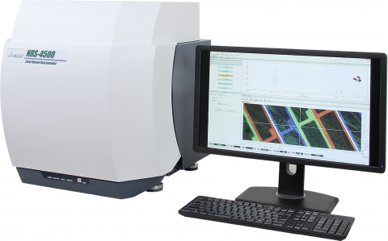
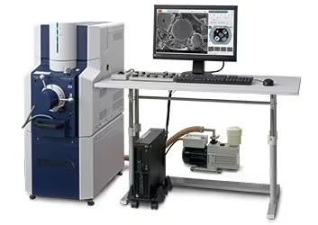
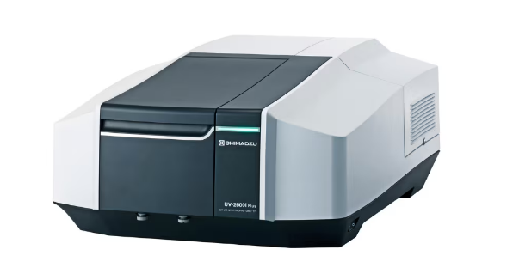
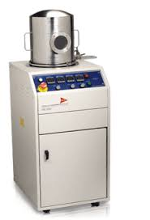
Confocal Raman Microscope (Jasco, NRS-4500, Japan)
2. Scanning Electron Microscope (SEM) (FlexSEM 1000 II, Japan)
3.UV-Vis Spectrophotometer (UV-2600 Shimadzu, Japan)
4.PDS 2010 Labcoter2 Parylene Deposition System (CVD) (SCS, USA)

Slide 6
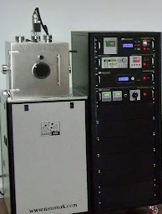
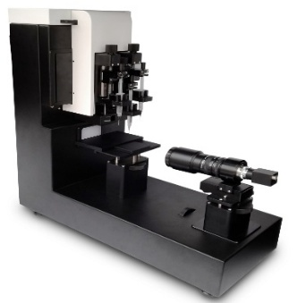
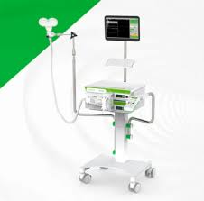
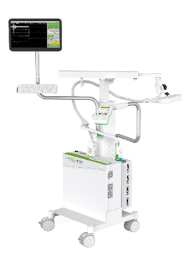
5. Physical Vapor Deposition System (PVD) (Nanovak, Türkiye)
6. Contact Angle Measurement System – Goniometer (Phoenix SEO, South Korea)
7. Paired-Pulse TMS Device (DEYMED Diagnostic s.r.o., Czech Republic)
8. Repetitive TMS Device (DEYMED Diagnostic s.r.o., Czech Republic)

Slide 7
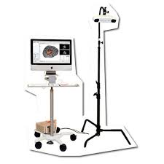
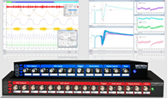
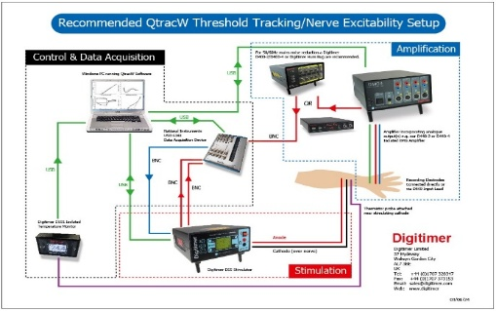
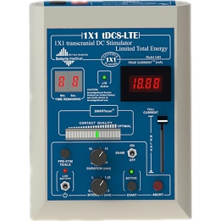
9. Neuronavigation System (Brainsight, Rogue Research Inc., Canada)
10. Motor Evoked Potential Recording System (Cambridge Electronic Design Limited, United Kingdom)
11.Threshold Tracking System (Qtrac, Digitimer Ltd., United Kingdom)
12.Transcranial Electrical Stimulation System (Soterix Medical Inc., USA)

Slide 8
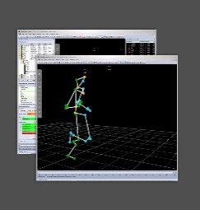
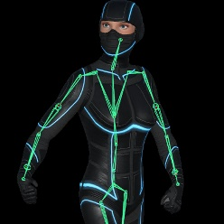
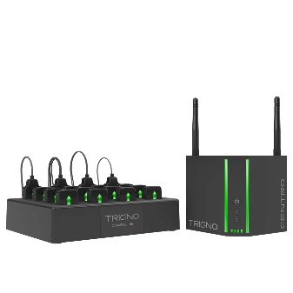
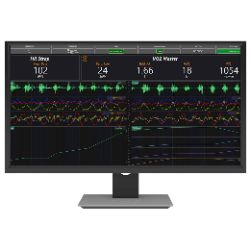
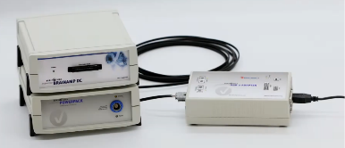
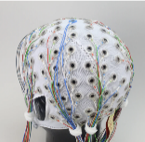
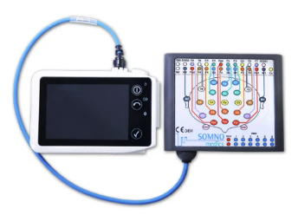
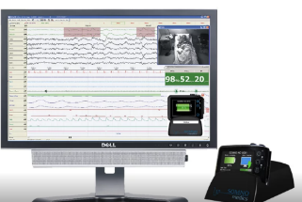
13. 8-Camera Motion Capture System (Qualisys Tracking System)
14. Delsys Wireless EMG System
15. TMS-EEG System (DEYMED Diagnostic SRO., Czech Republic, Brain Vision LLC, USA)
16. Brainamp 128-Channel EEG System (Brain Vision LLC, USA)
17. SOMNOMEDICS Polysomnography System [SomnoHD PSG Device & EEG Box, 32-Channel (SomnoMedics AG, Germany)]

Slide 9
Quota Numbers and Admission Requirements for the 2025/2026 Fall Semester

Slide 11
QUOTA |  |  | SCORE TYPE | PROGRAM TYPE | SCORE CRITERIA
MASTER’S DEGREE | DOCTORATE | FOREIGN NATIONAL MA/DR. |  |  | ALES SCORE/ *TUS* | FOREIGN LANGUAGE SCORE | GRADUATION GRADE (UNDERGRADUATE/MA)
2 |  | 0 | E.W./NUM | MASTER’S DEGREE | 70 | 70 | 2,50
 | 4 | 1 | E.W./NUM | DR. | 75 | 70 | 3,00
UNDERGRADUATE PROGRAMS ADMITTING STUDENTS

