Slide 1
HATASIZ MAKALE OLMAZ: İNGİLİZCE ÜZERİNE İPUÇLARI
GOOD SCIENCE DOES NOT EXCUSE POOR WRITING!

Slide 2
Temelde bir konuya ait özgün bir düşüncenin belirli bir sistematik ve kurallar çerçevesinde yazıya aktarılmasıdır (Aydın, 2015; 30).
* Lisans üstü tezler, makaleler, projeler, bilimsel raporlar, bildiriler vb.

Slide 3
AKADEMİK YAZIM DİLİ
1. Karmaşıklık: Akademik yazı karmaşıktır. Akademik yazı, konuşulan dilin aksine farklı bir çok dil bilgisel özelliklere sahiptir.
2. Kesinlik: Akademik için yazılı olarak bazı gerçekler ve rakamlar kesin olarak verilmelidir.
3. Formalite: Akademik yazı tarzı resmi olmalıdır.
4. Nesnellik: Yazılması gereken dil kişisel olmamalı, nesnel olmalıdır.
5. Doğruluk: Akademik yazmada yazar, kelimeleri doğru bir şekilde kullanmalıdır.
6. Açıklık: Akademik yazarlar, dili doğru kullanarak okuyuculara açıklamalıdırlar ve metinlerin farklı bölümlerini açık bir şekilde ilişkilendirmek zorundadır.
7.Organizasyon: Akademik yazı tamamen organize edilmelidir. Kısa ve mantıklı bir şekilde bir bölümden diğerine sorunsuz bir şekilde akmalıdır.

Slide 4
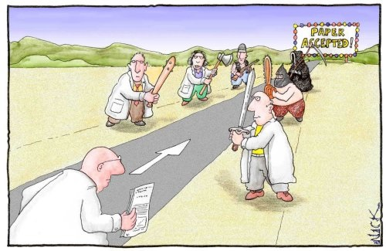
ZORLU BİR SÜREÇTİR!

Slide 5
NELER KONUŞACAĞIZ!
Theory
+
Practice

Slide 6
PRINCIPLE 1: WRITE WITH THE READER IN MIND
GOOD SCIENCE DOES NOT EXCUSE POOR WRITING*
*Hoffmann, A. H. (2009). Scientific writing and communication: papers, proposals, and presentations. Oxford: Oxford University Press.

Slide 7
PRINCIPLE 2: USE PRECISE WORDS
The current remained increased for several hours.
6 hours
Nests were observed frequently for signs of predation.
every two hours
The carbonate layer was prepared with sodium carbonate.
using

Slide 8
P3: USE SIMPLE WORDS/ OMIT UNNECESSARY WORDS OR PHRASES
Fractions of 0.8 ml were collected, reduced to dryness, and dissolved in methanol.
dried
Our results reflect deviations from thermal equilibrium during desorption.
deviate
In the analysis, Jacobson’s Scale was utilized.
used
This chapter serves to explain…
explains

Slide 9
P3: OMIT UNNECESSARY WORDS OR PHRASES
Most galaxies with unusually luminous cores are highly asymmetric in shape.
Formulations were optimized with using full factorial design.
Eddies have been shown to vary depending on the time of year.
It is known that there are three subtypes of the KL-2 virus.
For the determination of the release kinetic model, zero order, first order and Higuchi models were analysed.
To determine the release kinetic model,…
In the study, it is revealed that
▶The study reveals that
Patients who have Alzheimer’s disease
▶ Patients with Alzheimer’s disease.

Slide 10
P3: USE SIMPLE WORDS/ OMIT UNNECESSARY WORDS OR PHRASES
LONGER PHRASE | CONCISE WORD
I came to the realization that | I realize that
Concerning the matter of | About
During the course of | During
In the event that | If
Regardless of the fact that | Although
Due to the fact that | Because
In all cases | Always
At that point in time | Then
Prior to | Before
Keeping in mind | Considering

Slide 11
P3: USE SIMPLE WORDS/ OMIT UNNECESSARY WORDS OR PHRASES
LONGER PHRASE | CONCISE WORD
A considerable number of | Many
An adequate amount of | Enough
First of all | First
Has the capability of | Can
In the process of | During, While
For the purpose of | To
In light of the fact that | Because
An example of this is the fact that | For example
At no time | Never
In many cases | Often
With regard/reference to | About

Slide 12
P4: USE CORRECT WORDS/PHRASES

Slide 13
P4: USE CORRECT WORDS/PHRASES «common confused/misused words»
We examined the affect of Kl-3 on MZ1 cells.
effect ✓
Affect (v)
Effect (n)
The addition of Kl-3 to MZ1 cells effected their growth rate.
affected ✓
Many organisms adopt easily to minor changes in the environment.
Adopt: accept
Adapt: adjust
adapt ✓
We adapted a new protocol for DNA isolation.
adopted ✓
Analyze (v) Ame.
Analyse (v) Brt.
Analysis (n.sng)
Analyses (n. plr)
Foodstuff analyzes show that seafood and water are two major
PFA acids….
analyses ✓
The drug was administrated orally.
administered ✓
Administer: 1.apply 2.manage
Administrate: manage, oganize

Slide 14
P4: USE CORRECT WORDS/PHRASES «common confused words»
The patient displayed no symptoms of the disease.
A sign that the dog was sick was that she did not eat anymore.
For people
For animals
A case is but a patient is
followed
observed
Conditions and diseases are but patients are
evaluated
examined.
The binding of X to Z needs to be examined farther.
Farther: physical distance Further: quantity or time
further ✓
Precise measurements could not be taken because of levels of humidity.
The crystals were of sizes.
varying
various
Varying: changing
Various: different

Slide 15
P4: USE CORRECT WORDS/PHRASES
LANGUAGE TRANSFER ERRORS
______________________________________________________________________________________________________
3 participant did not want to give their personal informations.
The city is located in a smooth area.
This work is evaluated as an investment for both today and the future.
Participants / information
flat land/ flat area
considered
TO TRANSLATE OR NOT TO TRANSLATE!

Slide 16
P4: USE CORRECT WORDS/PHRASES
COLLOCATIONS!

Slide 17
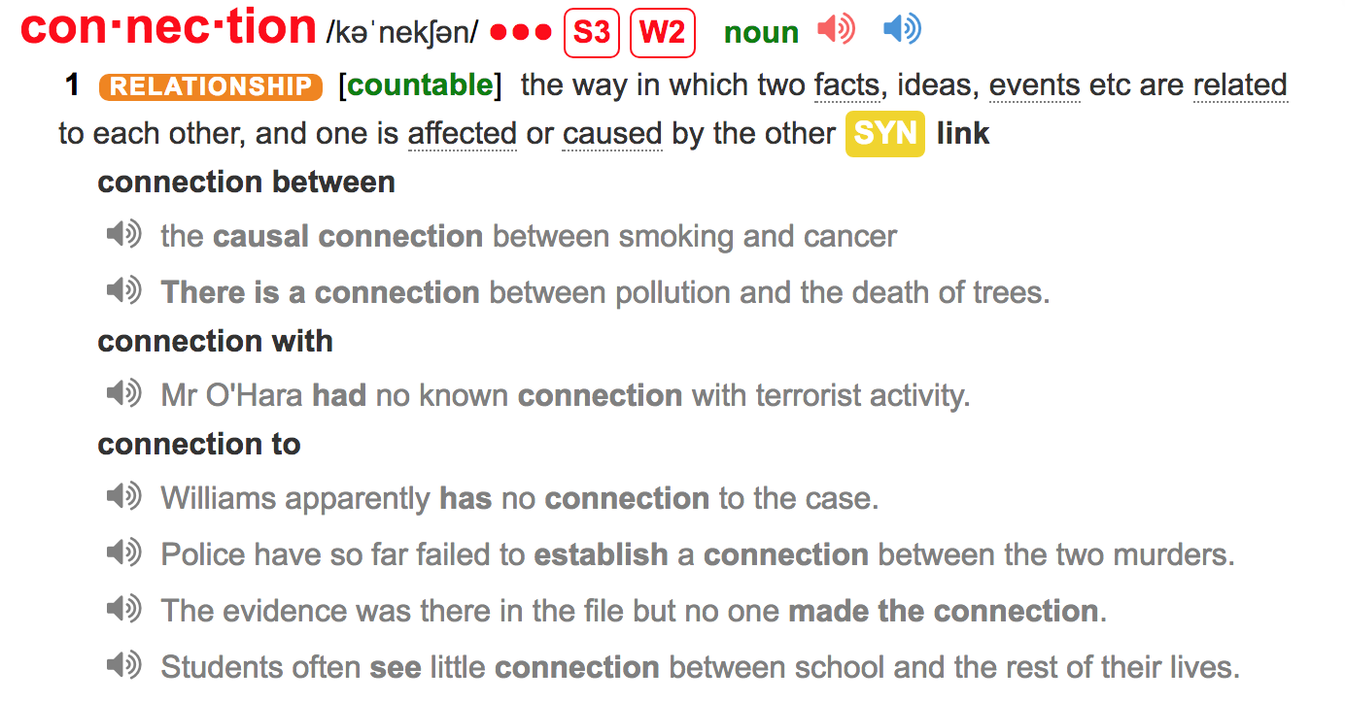
P4: USE CORRECT WORDS/PHRASES

Slide 18
P4: USE CORRECT WORDS/PHRASES
COLLOCATION DICTIONARY
GOOGLE SCHOLAR
MONOLINGUAL DICTIONARIES
RESEARCH STUDIES

Slide 19
P5: USE CORRECT PREPOSITIONS «using the wrong preposition»
The change of peoples’ choice to refer to a healthcare institution...
in ✓
with
When the results of this study were compared those of Paul et.al,
The human brain is compared a computer.
to
Compared to - unlike things
Compared with - like things
Algorithm results in the edges and junctions are shown on Figure 3.
Demographic information for this sample is shown at Table 1.
in ✓
in ✓
Hot liquid mixture was stirred for 45 min and 500 rpm in room temperature.
at ✓
…..due to the increase of lipophilicity.
in ✓

Slide 20
P5: USE CORRECT PREPOSITIONS «using an extra preposition»
▶ Sharing of professional knowledge… ▶ Reading of publications…
▶ Supporting of teachers…. ▶ Maintaining of the conditions…
▶ Providing of the necessary equipment…
▶ Inclusion of facilitation into ecological theory
▶ Including of facilitation into ecological theory
▶ The effects of omitting of daily medication on the pathophysiology of heart failure…
▶ The effects of omission of daily medication on the pathophysiology of heart failure…
✓
✓
▶ Studying in biological features of …
▶ ….with 500 species in all over the world.
▶ Pazopanib causes to an increase of lipa levels.
▶ Getting good results from these experiments requires to good field research first.

Slide 21
P6: COMMON ERRORS IN SPELLING
▶ Adress
▶ Ocur
▶ Analyze (n)
▶ Therefor
▶ Seperation
▶ Probablity
▶ Analitically
▶ determening
▶ Invetsigate
▶ Bivaraiate
▶ Defination
▶ Physycian
► Fourty
▶ Address
▶ Occur
▶ Analyses
▶ Therefore
▶ Separation
▶ Probability
▶ Analytically
▶ Determining
▶ Investigate
▶ Bivariate
▶ Definition
▶ Physician
► Forty
▶ Effect/affect
▶ Discrete/discreet
▶ Except/ expect

Slide 22
P7: PLACE INFORMATION CORRECTLY
OLD / FAMILIAR / SHORT + NEW / COMPLEX / LONG
Although Vitamin B6 seems to reduce the risk of macular degeneration, it may have some side effects.

Slide 23
P8: AVOID INTERRUPTIONS BETWEEN SENTENCE ELEMENTS
x
Dengue virus, a Flavivirus belonging to the family Flaviviridae, which includes over 60 known human pathogens such those causing yellow fever, is classified into four different stereotypes: Types 1, 2, 3, and 4.
Dengue virus is a Flavivirus belonging to the family Flaviviridae, which includes over 60 known human pathogens such those causing yellow fever. This virus is classified into four different stereotypes: Types 1, 2, 3, and 4.
✓

Slide 24
P8: AVOID INTERRUPTIONS BETWEEN SENTENCE ELEMENTS
x
We compared, using a model-based approximation computation method, the different introduction scenarios for the Western European populations.
We compared the different introduction scenarios for the Western European populations using a model-based approximation computation method.
✓
x
It is concluded, based on the experiments done in the current study, that solar variability is insignificant.
It is concluded that solar variability is insignificant based on the experiments done in the current study.
Based on the experiments done in the current study, it is concluded that solar variability is significant.
✓
✓

Slide 25
P9: BALANCE THE ACTIVE & PASSIVE VOICE
Çok fazla edilgen yapı ➤ sıkıcı ve yoğun
Çok fazla etken yapı ➤ fazla basit ve tuhaf
Akademik yazıda edilgen yapı bir süreci, çalışmanın sonuçlarını veya doğası gereği nesnel olan materyalleri tanımlamak için kullanılır. Ancak eylemleri tanımlamak için etken yapılar kullanılır.

Slide 26
P9: BALANCE THE ACTIVE & PASSIVE VOICE
…. In order to achieve this, we designed an experiment to test the impact on worker perceptions of well-being. Three test environments were selected for our experiments: a law office, a laboratory, and an automobile assembly line. One-way mirrored glass panels were installed to allow video cameras to record the activity, and the researchers took notes. We secretly inserted observers directly into the work environment. The observers were drawn from the students who were matriculated into the experimental psychology courses.

Slide 27
P9: BALANCE THE ACTIVE & PASSIVE VOICE «establishing importance»
topic stress topic stress
▼ ▼ ▼ ▼
Mosquitoes often carry parasites. Parasites are often carried by mosquitoes.

Slide 28
P10: USE THE FIRST PERSON
x
To determine the mechanism for the direct effect of contrast media on heart muscle mechanics, the study on heart muscles isolated from cats was carried out.
To determine the mechanism for the direct effect of contrast media on heart muscle mechanics, we carried out the study on heart muscles isolated from cats.
✓
x
The authors show here that two separate parameters are important to describe the physical effects of an earthquake.
We show here that two separate parameters are important to describe the physical effects of an earthquake.
✓
x
It is recommended by the authors of the present study that a triple regimen of antibiotics is given to infants with HIV.
We recommend that a triple regimen of antibiotics is given to infants with HIV.
✓

Slide 29
P11: USE THE CORRECT FORM OF THE VERB
► However, there is a blood-brain barrier which localized in the brain.
which is localized
► The flow curves defined by Ostwald de Waele equation given below:
are given
► Briefly, the donor cells were filled with formulations contain 40mg of RM.
containing
► Specific activities focusing on impairment could be positively changed performance.
could positively change

Slide 30
P12: USE THE CORRECT TENSE
Past Tense:
▶ Gözlemler, tamamlanan eylemler ve belirli sonuçlar
▶ Abstract: Finally, the model was applied on call detail records of a telecom company.
▶ Methods: The proposed model was developed with the MapReduce parallel programming paradigm, which provides simplicity and flexibility for large-scale applications.
▶ Results: As a result, these warnings were caused by behavioural changes that were not previously present in the user pattern.
Present Tense:
▶ Yayınlanmış makalelerden elde edilen sonuçlar,
▶Introduction:
Approaches based on machine learning try to differentiate legitimate users and fraudsters with various algorithms like artificial neural networks (Elmi et al., 2013) or decision trees (Murynets et al., 2014).

Slide 31
P12: USE THE CORRECT TENSE
Both past and present tense:
Çalışmanızı önceden oluşturulmuş bilgilerle ilişkilendirirken her ikisi de kullanılabilir.
▶Discussion
“Carri observed that certain species of bacteria respond to light stimuli.”
This study described the anatomy and histology of the male reproductive system in C. populi which is an economically important species belonging to the family Chrysomelidae.

Slide 32
P13: USE CORRECT PARALLEL FORM
x
The candidate’s goals include winning the election, a national health program, and the educational system.
The candidate’s goals include winning the election, enacting a national health program, and improving the educational system.
Inclusion criteria were being male, to have a chronic disease, and under 20 years of age.
Inclusion criteria were being male, having a chronic disease, and being under 20 years of age.
The results show that school administrators support teachers in acquiring information and focus on activities.
The results show that school administrators support teachers in acquiring information and focusing on activities.
Based on our hypothesis, we expected to see a decrease in the infection rate and the survival of patients will show an increase.
Based on our hypothesis, we expected to see a decrease in the infection rate and an increase in survival of patients.
✓
x
✓
x
✓
x
✓

Slide 33
P14: SUBJECT-VERB AGREEMENT
▶ TOCT included eleven workstations that was primarily focused on improving balance and gait
▶ These specimens was examined in….
▶ One of the methods used in the study were…
▶ The concentration of RM in samples were determined with the UV spectrophotometer.
▶ The blood and urine of each patient was examined.
▶ Our data suggests that...
▶ All the information presented in the article are shown.
were ✓
were ✓
was ✓
was ✓
were ✓
suggest✓
is ✓

Slide 34
P15: USE CORRECT PLURAL AND SINGULAR NOUN FORMS
Some words cannot be used in plural form.
Information
Equipment
Research (prefer “studies” or research studies)
Progress
Knowledge
Feedback

Slide 35
P15: USE CORRECT PLURAL AND SINGULAR NOUN FORMS
Plural | Singular
Data | Datum
Media | Medium
Criteria | Criterion
Phenomena | Phenomenon
Curricula | Curriculum
Hypotheses | Hypothesis
Theses | Thesis
Plural | Singular
Analyses | Analysis
Crises | Crisis
Indices | Index
Appendices | Appendix
Diagnoses | Diagnosis
Syllabi | Syllabus
Stimuli | Stimulus

Slide 36
P15: USE CORRECT PLURAL AND SINGULAR VERB FORMS
▶ These feedbacks are insufficient to….
▶ These inconsistency could be resulted from…
▶ This group of enzymes are known as…
▶ Temperature and time is both important parameters in …
▶ Neither the heart nor the lungs were inflamed.
▶ Not only the boys but also the girl was infectious.
▶ One-third of the patients were men. ▶ One-third of the sample was …
▶ This feedback is
▶ This
▶ is
▶ are

Slide 37
P16: WORD FORM «DISTINGUISH BETWEEN ADJECTIVE AND ADVERB FORMS»
Both groups showed significantly improvement.
There is a sharply decrease in the number of…
Suddenly increase in blood pressure might result in…
The number of people achieving high scores minor decreased.
Socially habits of young people.
significant ✓
Adj + Noun
Verb + Adv.
sharp ✓
sudden ✓
showed a minor decrease ✓
social ✓

Slide 38
P17: USING NUMBERS
▶ 0-9 arası rakamlar sayı ile ifade edilir.
Among the participants, two were excluded from the study.
▶ Birim ile ifade edilen değerler rakamla ifade edilir: 6 days, 32 hr, 7.8 gr.
▶ Cümle başında tüm rakamlar yazı ile ifade edilir.
Six hundred and three examinees participated in the experiment.
Of these, 34 survived to adulthood.
Among the participants, 32% achieved a high score.
▶ Büyük rakamlar yazı ile ifade edilir.
Three hundred animals frequented the water hole.
▶ Çok büyük rakamlar hem yazı hem rakam ile:
The bird population was estimated to be 1.3 million
!!! %30 ➤ 30%

Slide 39
P18: AVOID NEGATION
No additional work is needed in the absence of an emergency.
Additional work is only required in an emergency.
The literature did not focus on…
There is little research on…
No research has been conducted on…
There is a lack of studies conducted on…
No fewer than 6 people →
No more than 10 people →
at least 6 people
at most 10 people

Slide 40
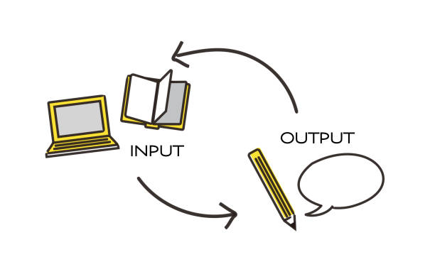

Slide 41
REFERENCES
Hacker, D. & Nancy Sommers (2011). A Writer’s Reference. Boston: Bedford/St. Martin’s.
Hoffmann, A. H. (2009). Scientific writing and communication: papers, proposals, and presentations. Oxford: Oxford University Press.
Hyland, K. (2007). Applying a gloss: exemplifying and reformulating in academic discourse. Applied Linguistics, 28/2: 266–285.

Slide 42
Öğr. Gör. Burcu ARSLANER ATALAY http://writing.gazi.edu.tr/ gaziyazma@gmail.com

